Slide 1
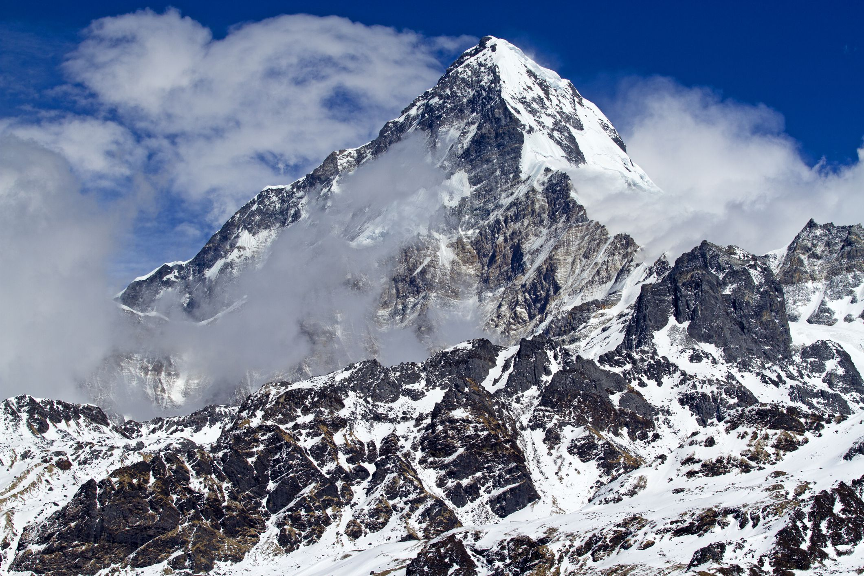
Team Bravo
Donovan Butcher, Tabark Kambal, Rachel Nelson, and Alex Vaccaro

Slide 2
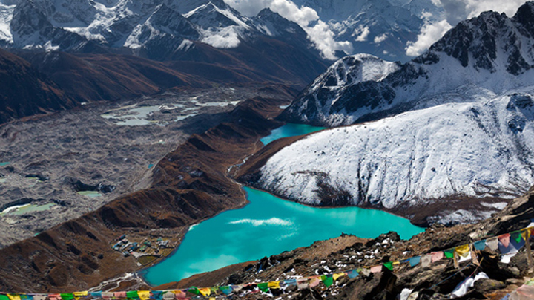
Introductions
Welcome to our SQL database report. Our group comprises Donovan Butcher, Tabark Kambal, Rachel Nelson and Alex Vaccaro. We chose a case study on Outland Adventures and used our knowledge of creating and managing SQL databases. We hope our database reports effectively show our knowledge and skills and look forward to sharing them with you.
Donovan lives in Thornville, Ohio and is a negotiations specialist. In his free time, Donovan enjoys spending time with family, hunting and fishing.
Rachel Nelson lives in Phoenix, Arizona, and is working as a pharmacy technician. Rachel enjoys taking her dog traveling, hiking, and spending time with friends and family.

Slide 3
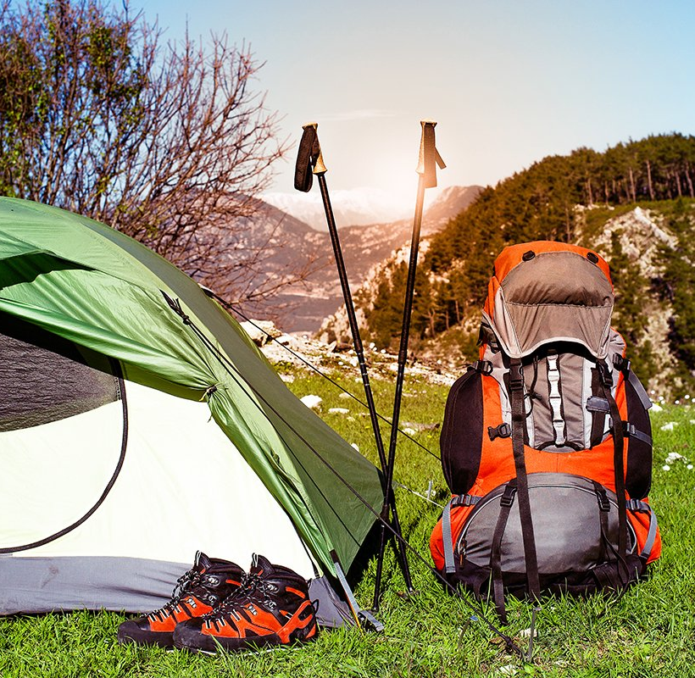
Mission
The Bravo team is a software development group working together to assist Blythe Timmerson and Jim Ford in improving different aspects of their business. Our goal is to optimize the organization of their e-commerce website by creating reports that will allow them to confidently make the best business decisions.

Slide 4

Brief Description of Case Study
Outland Adventures is a tour company that takes its customers on camping and hiking trips worldwide. The company owners would like to look closer at their last few years of data to ensure they spend their time and energy most profitably.
The company provides rental equipment for a daily rate and new equipment for customers to purchase.
They would like to analyze the number of equipment sales to determine if that portion of their business is worth retaining. Another aspect of their business is whether destinations have had a downward booking trend. Finally, the company would like to update its equipment rentals and replace any over five years old.

Slide 5
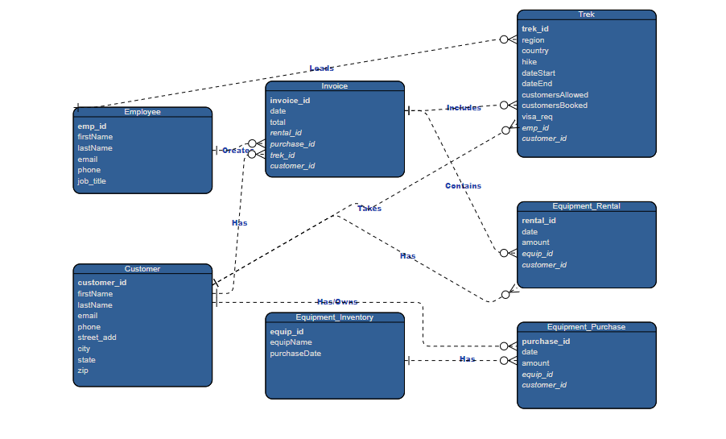
Entity Relationship Diagram

Slide 6
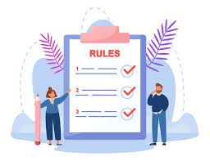
Business Rules
An Employee can create many Invoices
An Employee can lead many Treks
A Customer can have many Invoices
A Customer can have many Equipment Rentals
A Customer can have many Equipment Purchases
An Invoice can have many Treks
An Invoice can have many Equipment Rentals
An Invoice can have many Equipment Purchases
An Equipment Inventory can have many Equipment Rentals
An Equipment Inventory can have many Equipment Purchases

Slide 7
Reports Description
Report 1: Report One collects the data from Outland Adventure’s previous three years to determine if the total equipment sales for each year are significant enough to continue to sell equipment.
Report 2: The percentage of the trips booked is determined by accumulating the total number of customers that booked the trip versus the number of openings for that trip. The report separates the percentage of how booked each trip was by year.
Report 3: Report three collects the data on equipment age in inventory and displays any equipment that has a period over 5 years.

Slide 8
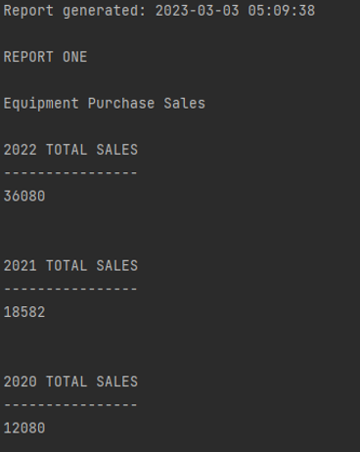
Report One
Do enough customers buy equipment to keep equipment sales?
The report indicates that equipment sales have continued to increase each year. The company can decide based on these results if the total amount of sales is worth keeping the department.

Slide 9
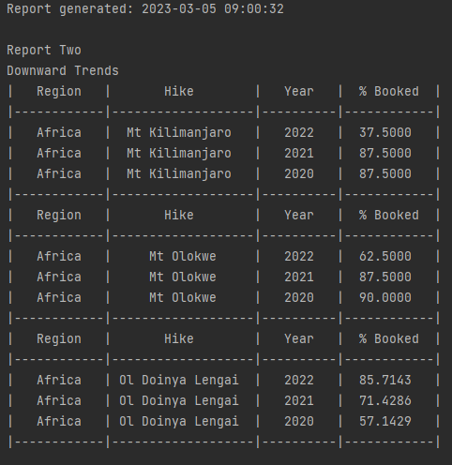
Report Two
African Treks
Report two collects the data from Outland Adventure’s trek bookings. The report displays a downward trend in trips to Mt. Kilimanjaro and Mt. Olokwe in Africa.

Slide 10
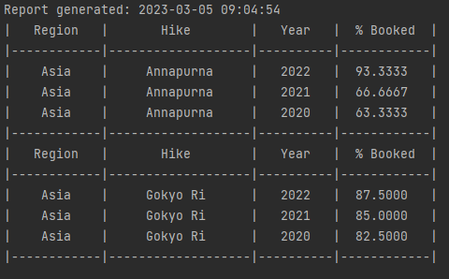
Two Continued
Asian Treks
Report two collects the data from Outland Adventure’s trek bookings. The treks in Asia have not shown a downward trend in the past three years.

Slide 11
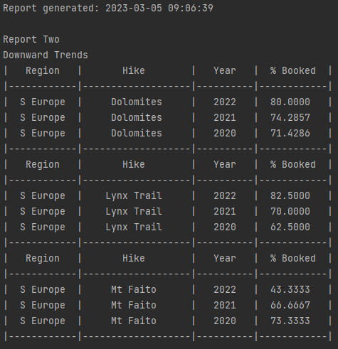
Two Continued
Southern European Treks
Report two collects the data from Outland Adventure’s trek bookings. The report displays a downward trend in trips Mt. Fiato in South Europe.
The company can decide whether to discontinue the trips to this destination or increase marketing.

Slide 12
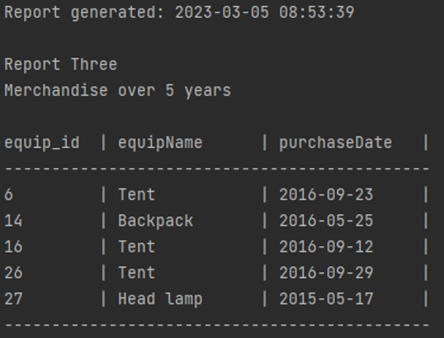
Report Three
Are there inventory items that are over five years old?
The equipment id, type of equipment, and the date purchased are shown to determine which equipment needs to be replaced. The equipment can be identified by the equipment id and either sold or donated if in usable condition

Slide 13
Thank you, Team Bravo
Donovan Butcher, Tabark Kambal, Rachel Nelson, and Alex Vaccaro

